Slide 1

SOP and POS forms
20XC14 DIGITAL SYSTEM DESIGN

Slide 2
Lecture Outline
Sum of Products / Product of Sums
Multiplying out and Factoring
Exclusive OR operation
Simplification
Proving equations (Validity)

Slide 3
Standard Forms of Boolean Expressions
All Boolean expressions, regardless of their form, can be converted into either of two standard forms:
The sum-of-products (SOP) form
The product-of-sums (POS) form
Standardization makes the evaluation, simplification, and implementation of Boolean expressions much more systematic and easier.

Slide 4
Sum OF Products(SOP)

Slide 5





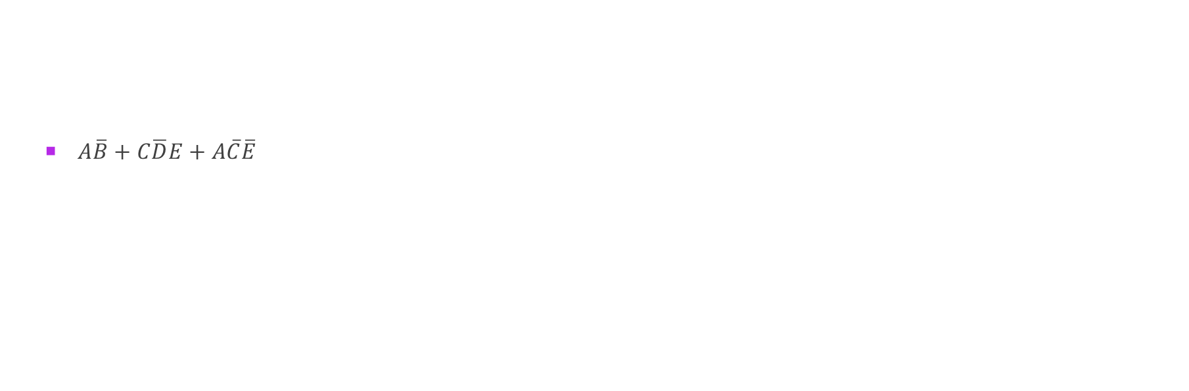







Sum of Products (SOP)
$A\overline{B}+C\overline{D}E+A\overline{C}\overline{E}$
$A\overline{B} + C\overline{D}E + A\overline{C}\overline{E}$
A sum of only products
SUMs
PRODUCTs
How can we implement SOP expressions?
$$A$$
$$A\overline{B}$$
$$\overline{B}$$
$$C$$
$$C\overline{D}E$$
$$A\overline{B}+C\overline{D}E+A\overline{C}\overline{E}$$
$$\overline{D}$$
$$E$$
$$A$$
$$\overline{C}$$
An AND – OR circuit!!!
$$\overline{E}$$
$$A\overline{C}\overline{E}$$

Slide 6
The Sum-of-Products (SOP) Form

Slide 8
STANDARD SOP FORM

Slide 10
Converting Product Terms to Standard SOP
Step 1: Multiply each nonstandard product term by a term made up of the sum of a missing variable and its complement. This results in two product terms.
As you know, you can multiply anything by 1 without changing its value.
Step 2: Repeat step 1 until all resulting product term contains all variables in the domain in either complemented or uncomplemented form. In converting a product term to standard form, the number of product terms is doubled for each missing variable.

Slide 11
Converting Product Terms to Standard SOP (example)

Slide 12
Product of Sums (POS)

Slide 13





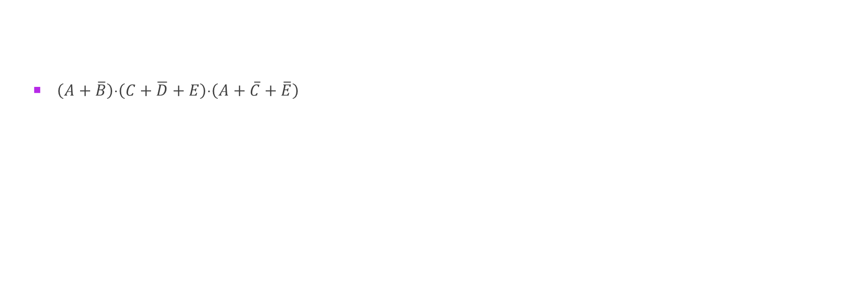







Product of Sums (POS)
$\left(A+\overline{B}\right)⋅\left(C+\overline{D}+E\right)⋅\left(A+\overline{C}+\overline{E}\right)$
$\left(A+\overline{B}\right) ⋅ \left(C+\overline{D}+E\right) ⋅ \left(A+\overline{C}+\overline{E}\right)$
A product of only sums
SUMs
PRODUCTs
How can we implement POS expressions?
$$A$$
$$A+\overline{B}$$
$$\overline{B}$$
$$C$$
$$\left(A+\overline{B}\right)⋅\left(C+\overline{D}+E\right)⋅\left(A+\overline{C}+\overline{E}\right)$$
$$\overline{D}$$
$$C+\overline{D}+E$$
$$E$$
$$A$$
An OR – AND circuit!!!
$$\overline{C}$$
$$\overline{E}$$
$$A+\overline{C}+\overline{E}$$

Slide 14
PRODUCT OF SUM EXPRESSION

Slide 15
Standard POS form

Slide 16
Converting a Sum Term to Standard POS
Step 1: Add to each nonstandard product term a term made up of the product of the missing variable and its complement. This results in two sum terms.
As you know, you can add 0 to anything without changing its value.
Step 2: Apply rule →A+BC=(A+B)(A+C).
Step 3: Repeat step 1 until all resulting sum terms contain all variable in the domain in either complemented or uncomplemented form.

Slide 17
Converting a Sum Term to Standard POS (example)

Slide 18
SOP/POS

Slide 19
Converting Standard SOP to Standard POS
The Facts:
The binary values of the product terms in a given standard SOP expression are not present in the equivalent standard POS expression.
The binary values that are not represented in the SOP expression are present in the equivalent POS expression.

Slide 20
Converting Standard SOP to Standard POS
What can you use the facts?
Convert from standard SOP to standard POS.
How?
Step 1: Evaluate each product term in the SOP expression. That is, determine the binary numbers that represent the product terms.
Step 2: Determine all of the binary numbers not included in the evaluation in Step 1.
Step 3: Write the equivalent sum term for each binary number from Step 2 and express in POS form.

Slide 21
Converting Standard SOP to Standard POS (example)

Slide 22
Boolean Expressions & Truth Tables
All standard Boolean expression can be easily converted into truth table format using binary values for each term in the expression.
Also, standard SOP or POS expression can be determined from the truth table

Slide 23
Converting SOP Expressions to Truth Table Format
Recall the fact:
An SOP expression is equal to 1 only if at least one of the product term is equal to 1.
Constructing a truth table:
Step 1: List all possible combinations of binary values of the variables in the expression.
Step 2: Convert the SOP expression to standard form if it is not already.
Step 3: Place a 1 in the output column (X) for each binary value that makes the standard SOP expression a 1 and place 0 for all the remaining binary values.

Slide 24
Converting SOP Expressions to Truth Table Format (example)

Slide 25
Converting POS Expressions to Truth Table Format
Recall the fact:
A POS expression is equal to 0 only if at least one of the product term is equal to 0.
Constructing a truth table:
Step 1: List all possible combinations of binary values of the variables in the expression.
Step 2: Convert the POS expression to standard form if it is not already.
Step 3: Place a 0 in the output column (X) for each binary value that makes the standard POS expression a 0 and place 1 for all the remaining binary values.

Slide 26
Converting POS Expressions to Truth Table Format (example)
POS

Slide 27
Determining Standard Expression from a Truth Table

Slide 28
Determining Standard Expression from a Truth Table

Slide 29
Determining Standard Expression from a Truth Table (example)

Slide 30
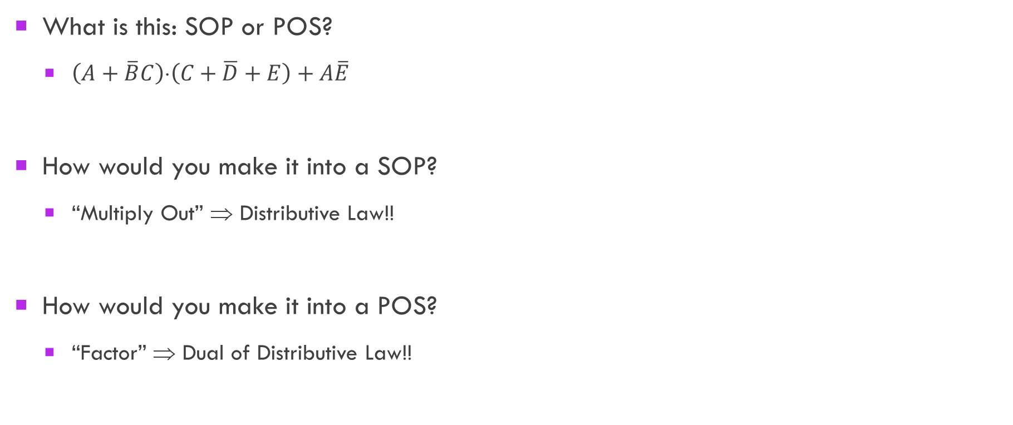
SOP and POS forms SOP and POS
What is this: SOP or POS?
$\left(A+\overline{B}C\right)⋅\left(C+\overline{D}+E\right)+A\overline{E}$
How would you make it into a SOP?
“Multiply Out” ⇒ Distributive Law!!
How would you make it into a POS?
“Factor” ⇒ Dual of Distributive Law!!

Slide 31


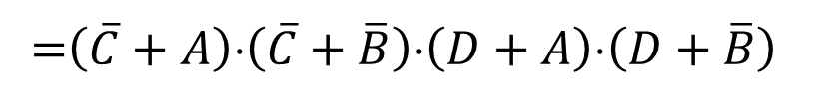

Converting between SOP and POS
“Multiply out” to convert POS to SOP
$\left(A+\overline{B}\right)⋅\left(C+\overline{D}\right)$ ⇒
“Factor” to convert SOP to POS
$A\overline{B}+\overline{C}D$ ⇒
$$AC+A\overline{D}+\overline{B}C+\overline{B}\overline{D}$$
Distributive Law
POS
SOP
x ⋅ (y + z) = x ⋅ y + x ⋅ z
$$\left(A\overline{B}+\overline{C}\right)⋅\left(A\overline{B}+D\right)$$
SOP
=$\left(\overline{C}+A\right)⋅\left(\overline{C}+\overline{B}\right)⋅\left(D+A\right)⋅\left(D+\overline{B}\right)$
POS
Distributive Law (Dual)
x + y ⋅ z = (x + y) ⋅ (x + z)

Slide 32
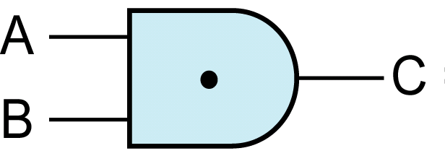

NAND and NOR Gates NAND Gate
Logical NAND
Description:
The output is the inverse (i.e. NOT) of an AND gate
Symbolic Representation (NAND gate):
Truth Table Representation:
Boolean Description: $C=\overline{A⋅B}$
What happens if we “push” the bubble (from output to input)?
A | B | C
0 | 0 | 1
0 | 1 | 1
1 | 0 | 1
1 | 1 | 0

Slide 33
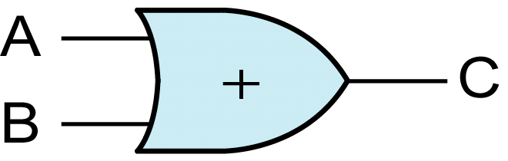
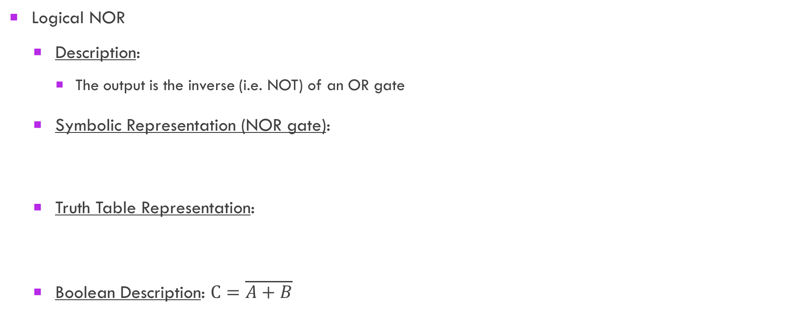
NOR Gate
What happens if we “push” the bubble (from output to input)?
Logical NOR
Description:
The output is the inverse (i.e. NOT) of an OR gate
Symbolic Representation (NOR gate):
Truth Table Representation:
Boolean Description: $C=\overline{A+B}$
A | B | C
0 | 0 | 1
0 | 1 | 0
1 | 0 | 0
1 | 1 | 0

Slide 34
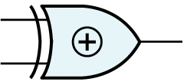


Exclusive OR operation -Exclusive-OR Gate
Exclusive-OR (XOR)
Description:
The output is true if one and only one of its inputs is true
Symbolic Representation (XOR gate):
Truth Table Representation:
Boolean Description: $C=A  B$
A
C
B
A | B | C
0 | 0 | 0
0 | 1 | 1
1 | 0 | 1
1 | 1 | 0
$$=\overline{A}B+A\overline{B}$$

Slide 35










Exclusive OR operation Some Exclusive-OR Operations
$$X0=$$
$$X$$
$$X1=$$
$$\overline{X}$$
$$XX=$$
$$0$$
$$X⊕\overline{X}=$$
$$1$$
$XY=$ $YX$
$\left(X ⊕ Y\right) ⊕ Z=$ $X⊕\left(Y ⊕ Z\right)$

Slide 36


Exclusive OR operation-Exclusive-OR Gate
Exclusive-NOR (XNOR)
Description:
The output is true if all of its inputs are equivalent
Symbolic Representation (XNOR gate):
Truth Table Representation:
Boolean Description: $C=\overline{A⊕B}$
Sometimes referred to as the “equivalence” gate
A
C
B
A | B | C
0 | 0 | 1
0 | 1 | 0
1 | 0 | 0
1 | 1 | 1
$$=\overline{A}\overline{B}+AB$$

Slide 37
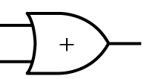
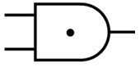









Converting SOP to NAND – NAND Circuits
Implementing SOP expressions using NAND gates:
A NAND – NAND circuit!!!
An AND – OR circuit!!!
$$A$$
$$\overline{B}$$
$$C$$
$$A\overline{B}+C\overline{D}E+A\overline{C}\overline{E}$$
$$\overline{D}$$
$$E$$
$$A$$
$$\overline{C}$$
$$\overline{E}$$
≡

Slide 38









Converting POS to NOR – NOR Circuits
Implementing POS expressions using NOR gates:
An NOR – NOR circuit!!!
An OR – AND circuit!!!
$$A$$
$$\overline{B}$$
$$C$$
$$\left(A+\overline{B}\right)⋅\left(C+\overline{D}+E\right)⋅\left(A+\overline{C}+\overline{E}\right)$$
$$\overline{D}$$
$$E$$
$$A$$
$$\overline{C}$$
$$\overline{E}$$
≡

Slide 40



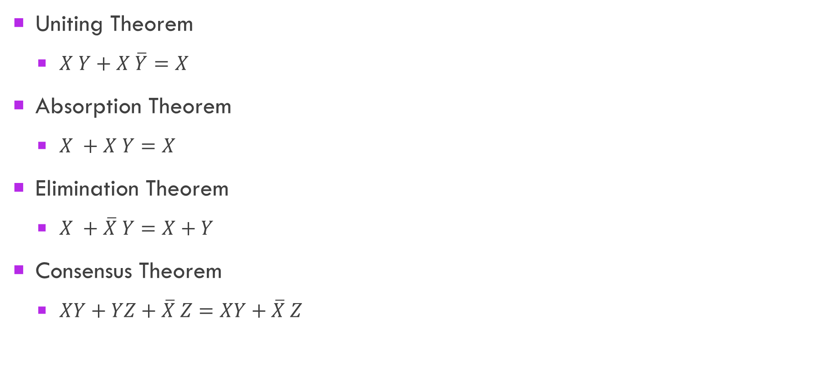

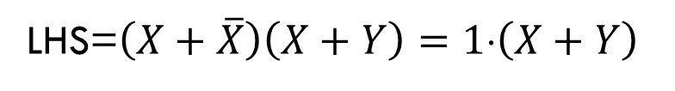

Review of Simplification Theorems
Uniting Theorem
$X Y+X \overline{Y}=X$
Absorption Theorem
$X +X Y=X$
Elimination Theorem
$X +\overline{X} Y=X+Y$
Consensus Theorem
$XY+YZ+\overline{X} Z=XY+\overline{X} Z$
$$LHS=X \left(Y+\overline{Y}\right)=X⋅1=X$$
$$LHS=X⋅1+XY=X \left(1+Y\right)=X$$
LHS=$\left(X+\overline{X}\right)\left(X+Y\right)=1⋅\left(X+Y\right)$
$$LHS=XY+\left(X+\overline{X}\right)YZ+\overline{X} Z$$
$$=XY+XYZ+\overline{X}YZ+\overline{X} Z$$
$$=XY\left(1+Z\right)+\overline{X} Z\left(Y+1\right)$$
$$=XY⋅1+\overline{X} Z⋅1$$

Slide 41
Proving Equations (Validity)
To prove the validity of an equation we can:
Construct a truth table for each side of the eqn
Need to observe all possible inputs and associated outputs
Apply theorems to either or both sides
Can apply duality to both the LHS and the RHS
Can apply DeMorgan’s theorem (i.e. push bubbles)
Could show that the circuit implementation of each side yields the same output- For possible ALL inputs

Slide 42
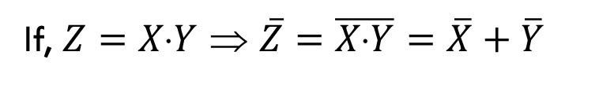


Examples
Find the complement of
$Z=\left(\overline{A}+B\right)\overline{C}$
Convert the following into a SOP expression
$\overline{\overline{AB}+\overline{C}\overline{D}}$
Find the Dual of the Elimination Theorem
$X +\overline{X}∙Y=X+Y$
If, $Z=XY$ ⇒ $\overline{Z}=\overline{X⋅Y}=\overline{X}+\overline{Y}$
$$\overline{X+Y}=\overline{X}⋅\overline{Y}$$

Slide 43
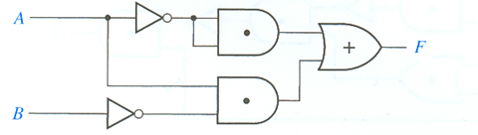










Boolean Algebra -A Circuit Example
Determine the Output of the Following Circuit
$$\overline{A}$$
$$\overline{A} \overline{A}$$
$$\overline{A} \overline{A}+A\overline{B}$$
$$A\overline{B}$$
$$\overline{B}$$
Design a Simpler Circuit with the Same Output
$$F=\overline{A} \overline{A}+A\overline{B}$$
Distributive Law (Dual)
$$=\overline{A}+A\overline{B}$$
x + (y ⋅ z) = (x + y) ⋅ (x + z)
$$=\left(\overline{A}+A\right)\text{⋅}\left(\overline{A}+\overline{B} \right)$$
$$=1\text{⋅}\left(\overline{A}+\overline{B} \right)$$
$$=\overline{A}+\overline{B}$$

Slide 44
EXAMPLE
Ben is having a picnic. He won’t enjoy it if it rains or if there are ants. Design a circuit that will output TRUE only if Ben enjoys the picnic.
The inputs are A and R, which indicate if there are ants and if it rains.
A is TRUE when there are ants and FALSE when there are no ants.
Similarly for rain R
Using sum-of-products form, we write the equation as: E= A’R’

Slide 45
The system has four inputs, A3, . . . , A0, and four outputs, Y3, . . . , Y0. These signals can also be written as A3:A0 and Y3:Y0.
Each user asserts her input when she requests the auditorium for the next day. The system asserts at most one output, granting the auditorium to the highest priority user. The dean, who is paying for the system, demands highest priority (3). The department chair, teaching assistant, and dorm social chair have decreasing priority.
Write a truth table and Boolean equations for the system. Sketch a circuit that performs this function.

